Slide 1
LAB1 - Decision Tree
Rui Chen & Yuji Zhao
17 Sep, 2019

Slide 2
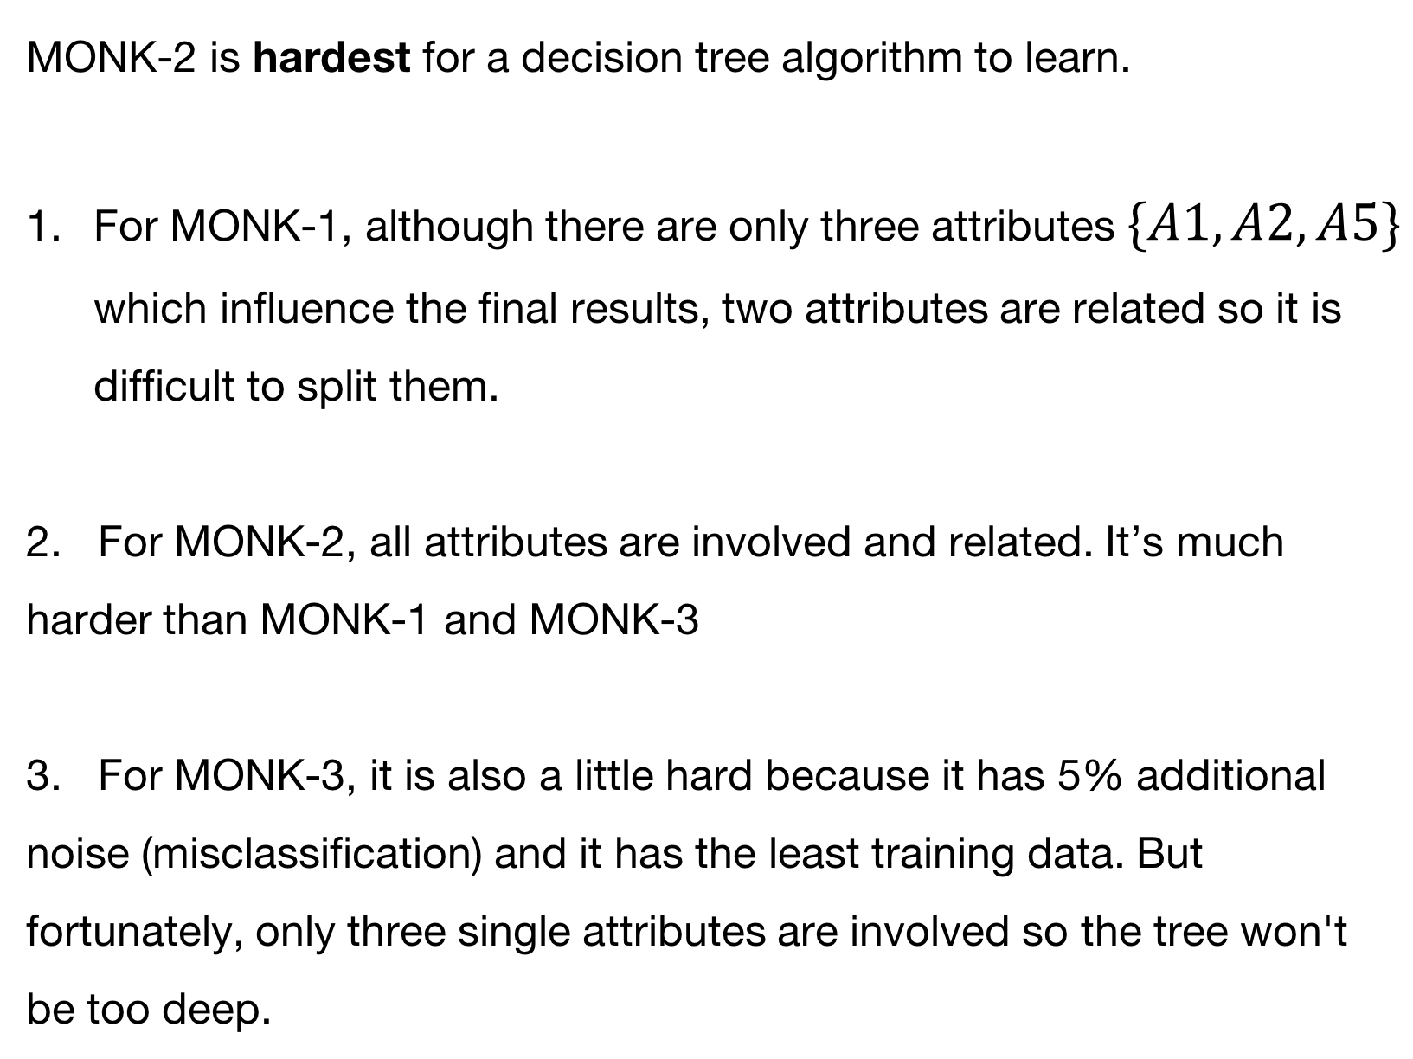
Assignment 0
MONK-2 is hardest for a decision tree algorithm to learn.
For MONK-1, although there are only three attributes $\{A1,A2,A5\}$ which influence the final results, two attributes are related so it is difficult to split them.
2. For MONK-2, all attributes are involved and related. It’s much harder than MONK-1 and MONK-3
3. For MONK-3, it is also a little hard because it has 5% additional noise (misclassification) and it has the least training data. But fortunately, only three single attributes are involved so the tree won't be too deep.

Slide 3
Assignment 1
The entropy for all datasets:
Dataset | Entropy
MONK1 | 1.0
MONK2 | 0.957117
MONK3 | 0.999806

Slide 4
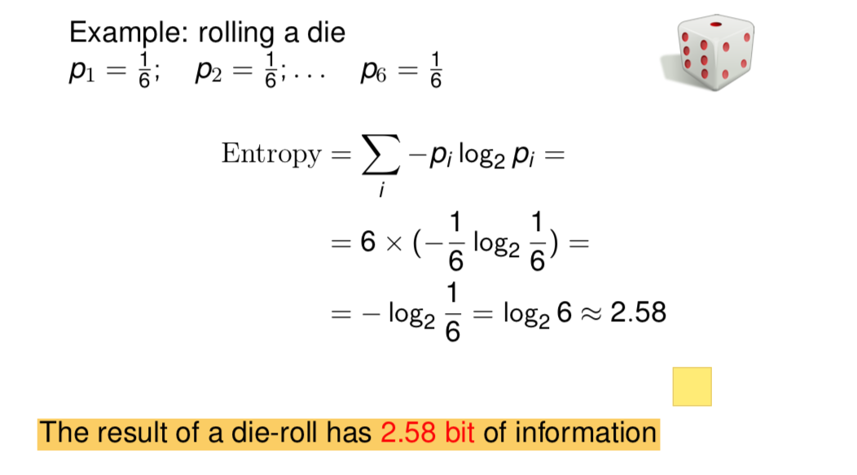
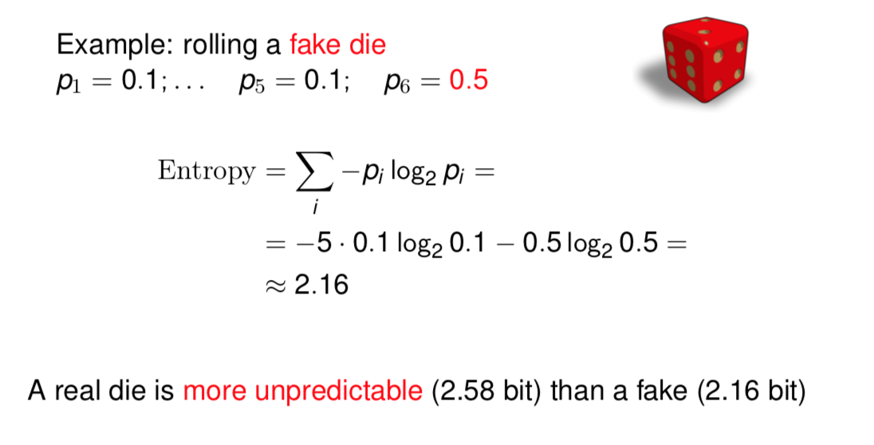
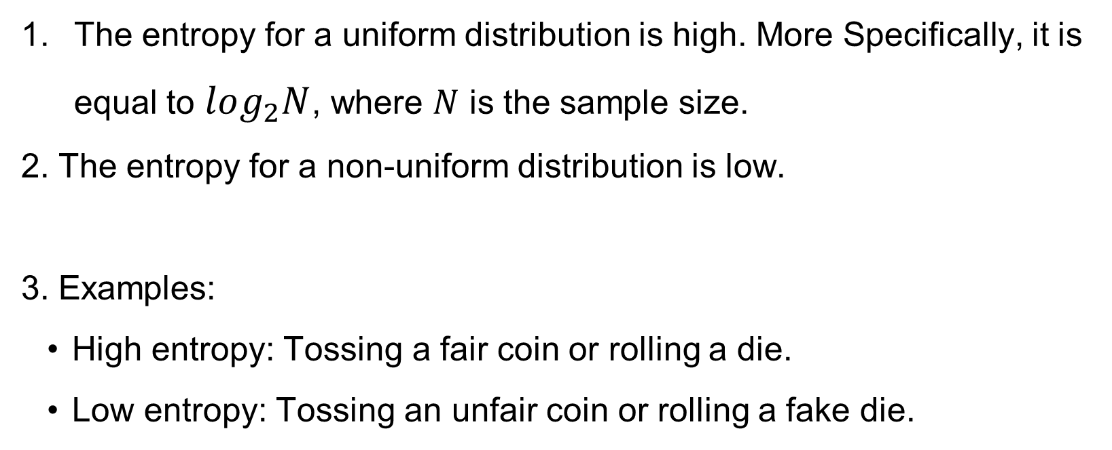
Assignment 2
The entropy for a uniform distribution is high. More Specifically, it is equal to $log_{2}N$, where $N$ is the sample size.
2. The entropy for a non-uniform distribution is low.
3. Examples:
High entropy: Tossing a fair coin or rolling a die.
Low entropy: Tossing an unfair coin or rolling a fake die.

Slide 5
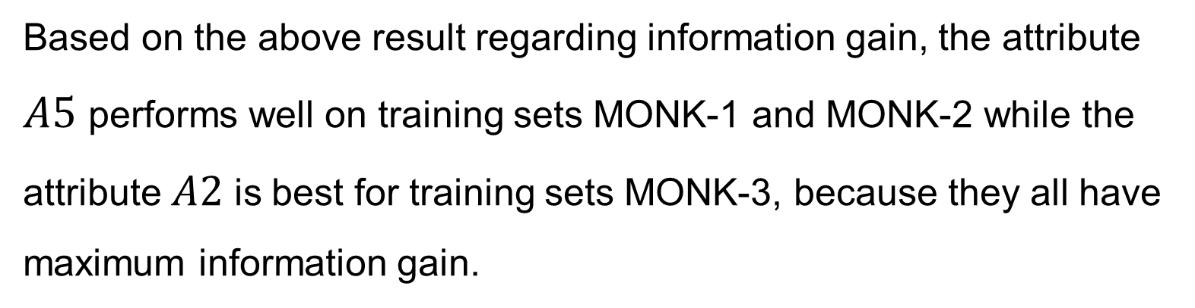
Assignment 3
Information Gain
Dataset | A1 | A2 | A3 | A4 | A5 | A6
MONK1 | 0.07527 | 0.00584 | 0.00471 | 0.02631 | 0.28703 | 0.00076
MONK2 | 0.00376 | 0.00246 | 0.00106 | 0.01566 | 0.01728 | 0.00625
MONK3 | 0.00712 | 0.29374 | 0.00083 | 0.00289 | 0.25591 | 0.00708
Based on the above result regarding information gain, the attribute $A5$ performs well on training sets MONK-1 and MONK-2 while the attribute $A2$ is best for training sets MONK-3, because they all have maximum information gain.

Slide 6
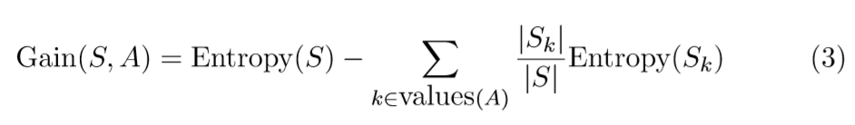
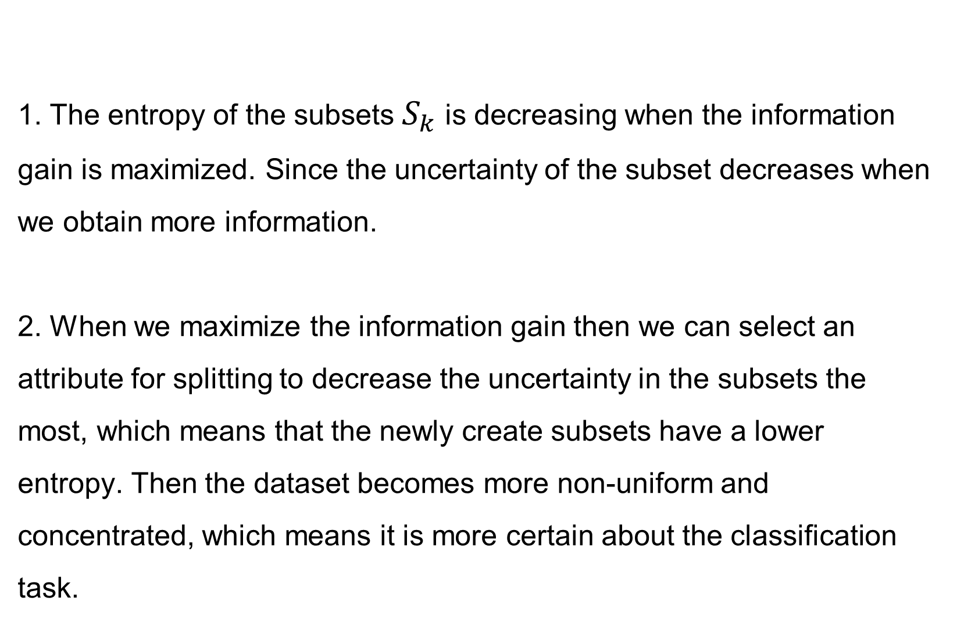
Assignment 4
1. The entropy of the subsets $S_{k}$ is decreasing when the information gain is maximized. Since the uncertainty of the subset decreases when we obtain more information.
2. When we maximize the information gain then we can select an attribute for splitting to decrease the uncertainty in the subsets the most, which means that the newly create subsets have a lower entropy. Then the dataset becomes more non-uniform and concentrated, which means it is more certain about the classification task.

Slide 7
Before Assignment 5
Q1: Split the monk1 data into subsets according to the selected attribute using the function select (again, defined in dtree.py) and compute the information gains for the nodes on the next level of the tree. Which attributes should be tested for these nodes?
Dataset | A1 | A2 | A3 | A4 | A5 | A6
dataset1 | 0.0 | 0.0 | 0.0 | 0.0 | 0.0 | 0.0
dataset2 | 0.04022 | 0.01506 | 0.03727 | 0.04889 | 0.0 | 0.02581
dataset3 | 0.03306 | 0.0022 | 0.01798 | 0.01912 | 0.0 | 0.04511
dataset4 | 0.20629 | 0.0339 | 0.02591 | 0.07593 | 0.0 | 0.00332
For A5 == 1: The dataset is pure, you don't need to test any attributes
For A5 == 2: attribute A4 should be tested
For A5 == 3: attribute A6 should be tested
For A5 == 4: attribute A1 should be tested

Slide 8
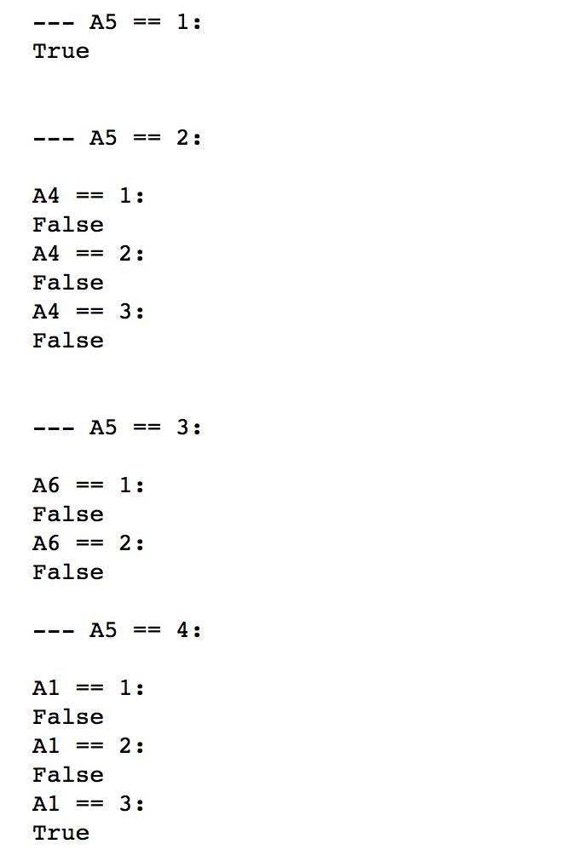
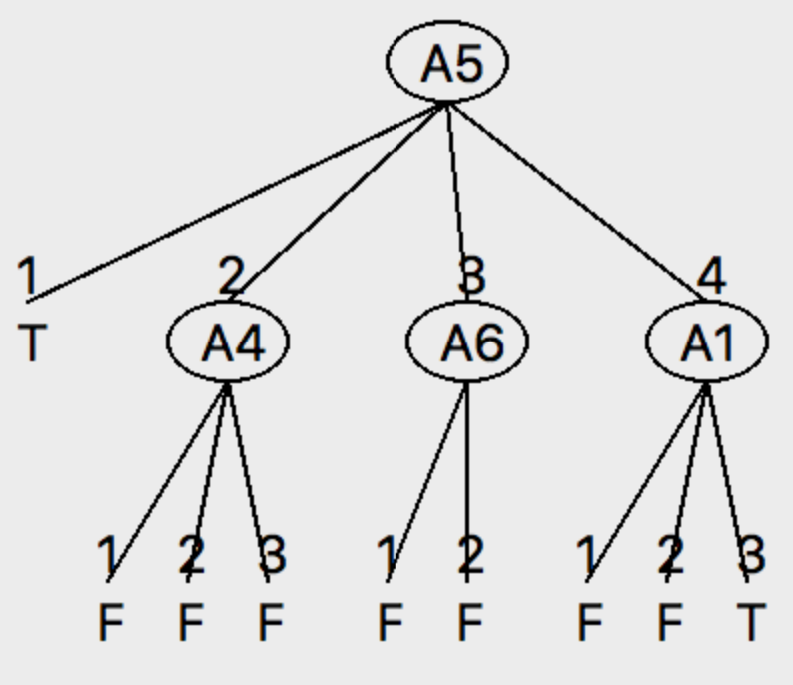
Before Assignment 5
Q2: For the monk1 data draw the decision tree up to the first two levels and assign the majority class of the subsets that resulted from the two splits to the leaf nodes. Then compare your results with that of a predefined routine for ID3.
Generated Manually
Generated by predefined routine

Slide 9
Assignment 5 & 6
Dataset | E-train | E-test
MONK1 | 0.0 | 0.1713
MONK2 | 0.0 | 0.30787
MONK3 | 0.0 | 0.05556
Variance refers to the amount by which the decision tree would change if we estimated it using a different training data set while bias refers to the error that is introduced by approximating a real-life problem.
Decision trees always have a higher variance since the models are over-complex and overfitting due to growing a full tree which fits for all rules. Therefore, pruning the tree can increase the bias and reduce the variance.

Slide 10
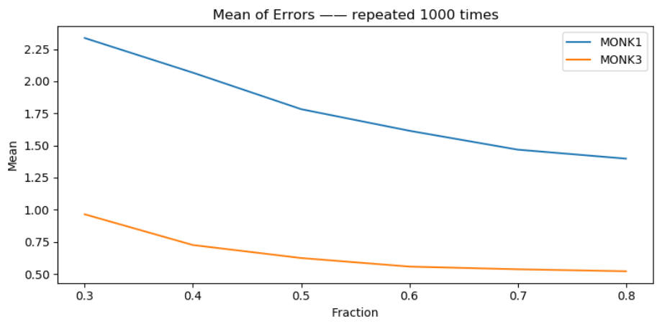
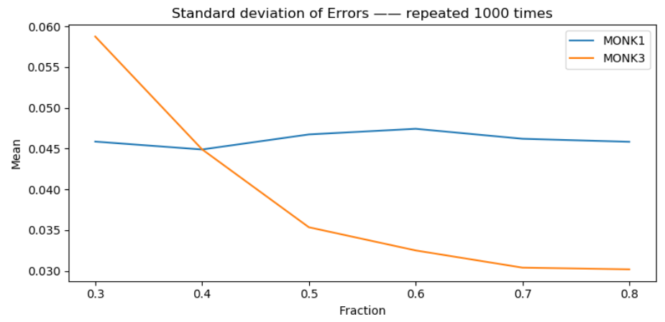
Assignment 7
Dataset | 0.3 | 0.4 | 0.5 | 0.6 | 0.7 | 0.8
MONK1 - MEAN | 0.23247 | 0.20644 | 0.17612 | 0.16445 | 0.14557 | 0.13816
MONK3 - MEAN | 0.09554 | 0.07182 | 0.06133 | 0.05606 | 0.05424 | 0.05456
MONK1 - STD | 0.04372 | 0.04529 | 0.04706 | 0.04882 | 0.04485 | 0.04846
MONK3 - STD | 0.06041 | 0.04395 | 0.03519 | 0.03138 | 0.02916 | 0.02736

